Slide 1
Martin Krzywinski
martin@bcgsc.ca
http://mkweb.bcgsc.ca/circos

Slide 2
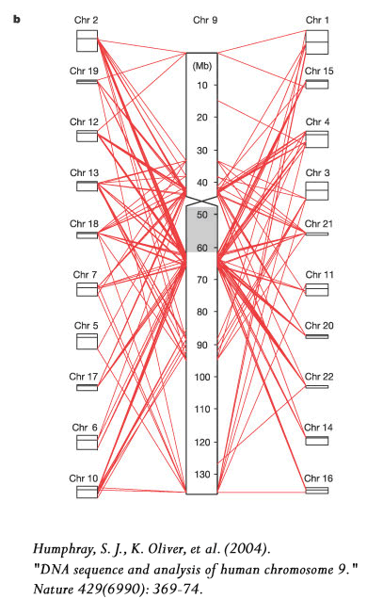
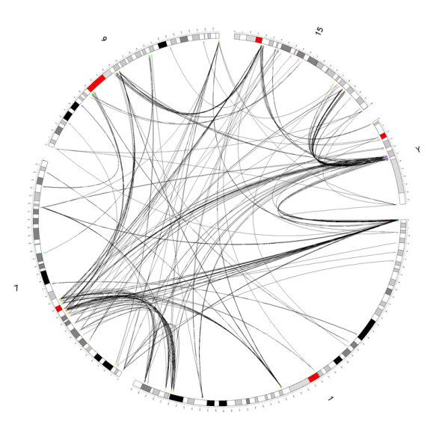
What is Circos?
Circos makes drawing certain kinds of data easier and produces meaningful images that make data interpretation easy
Circos is ideally suited for imaging relationship between positional data
  a relationship between two locations on an integer line (e.g. a chromosome)
  a relationship between two objects in a set
by compositing the axes circularly, instead of along straight lines, relationship views become less cluttered
image
by Circos
instead of this
how about this?

Slide 3
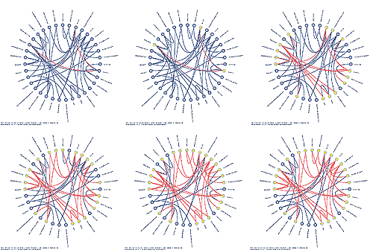
Focus on Genomic Data
since I work in genomics, I have spent most of my time applying Circos to data in this field, but circular axis layout can be applied to visualizing other data (e.g. database table relationships)
this talk will focus on genomics, though
image by Schemaball shows
foreign key relationships
between tables in a database
here, each glyph along the
circle represents a table, and
joining lines represent foreign
keys
mkweb.bcgsc.ca/schemaball

Slide 4
Why Reinvent the Wheel – Another Browser?
there are many genome browsers already available – do we really need another? U
  UCSC genome browser (genome.ucsc.edu)
  Ensembl (ensembl.org)
  Vista (pipeline.lbl.gov/cgi-bin/gateway2)
  VEGA (vega.sanger.ac.uk)
  ARGO (www.broad.mit.edu/annotation/argo)
I think we do, to draw data structures that obfuscate common diagram formats
  standard 2D plots (2 perpendicular axes) are inadequate for data that relate two genomic positions (e.g. alignments, conservation)
  a custom axis layout (e.g. circular, like in Circos) can help
communicating data visually is critical for large data sets
  very applicable to genomics, where positional features (e.g. genes) are much smaller than the data domain (e.g. chromosome)
  particularly important when data sets are complex, with latent patterns

Slide 5
Types of Data Relationships
in a general sense, data is either scalar or vector, and mappings between data are either scalar, or vector valued
the genome is a 1-dimensional data structure – a genomic position is thus a scalar
 |  | output
 |  | scalar | vector
input | scalar | GC content, coverage scatter, line, histogram | alignments (duplications, synteny) end sequence alignments, clone mappings colour map, ideograms connected by lines, tilings
 | vector | alignment identity (duplications, synteny) dot plot, colour map, surface/solid plot | generalized alignments hard

Slide 6
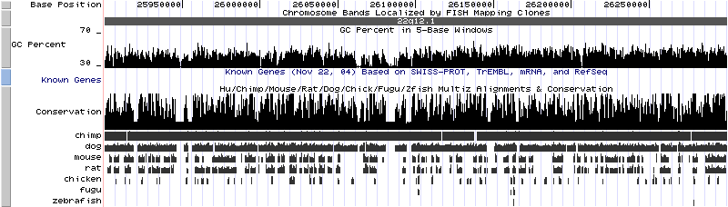
Scalar to Scalar Mappings
scalar valued mappings are very common and easily handled
  input genomic position is a scalar input
  when the output is real-valued (GC content, degree of conservation, etc) use a histogram, line plot, scatter plot
    genome position on x-axis
    function value on y-axis
  this works very well when the dynamic range of the range is much smaller than the domain
UCSC Genome Browser (hg17)

Slide 7
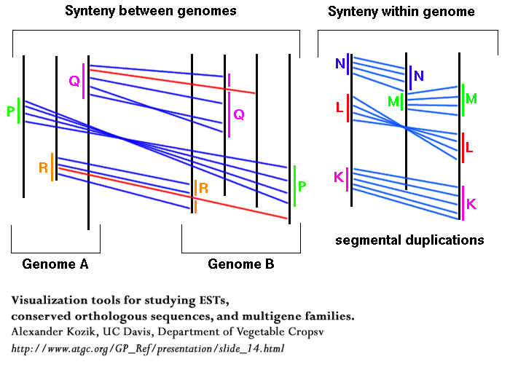
Scalar to Scalar Mappings
trouble arises when the output scalar is also a genome position
  range may be the same genome, or a different genome
  in this case, the dynamic range of the domain is comparable to the range (3Gb-to-3Gb)
genome
position
genome
position

Slide 8
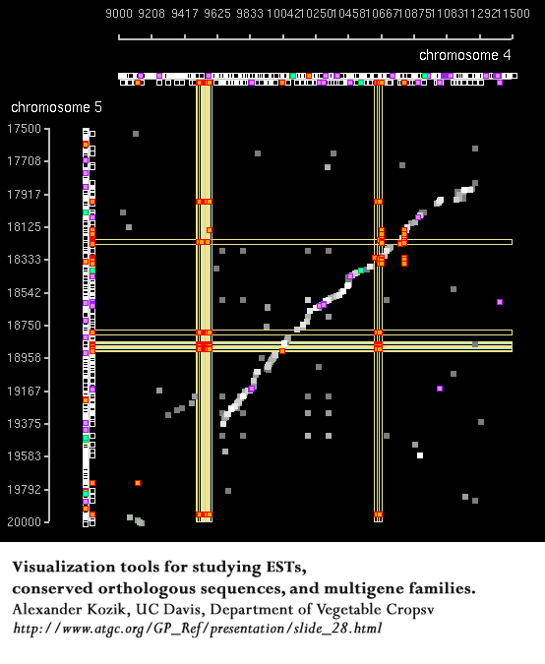
Scalar to Scalar Mappings
if the domain in g and range in g’ is small, a square dotter-like plot can be used

Slide 9
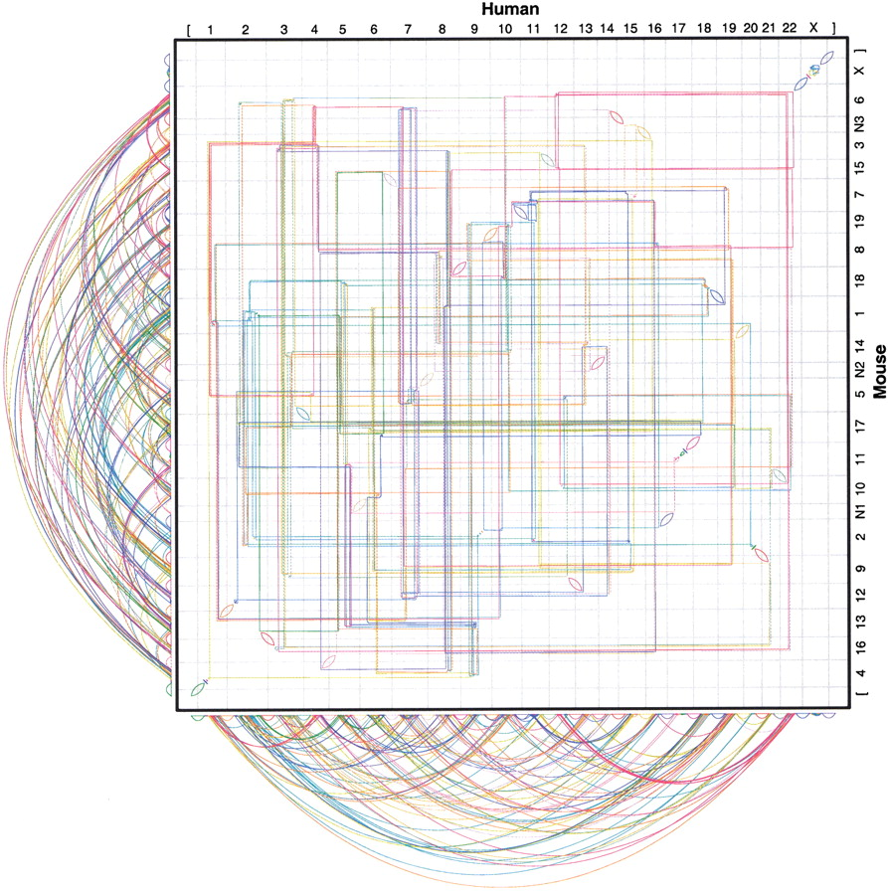
Genome-to-Genome Mappings
dotter-type plots in which g and g’ are the entire genome, or span large distances, are hard to interpret
  enormous dynamic range in data
  routing lines becomes difficult
Genome Res. 2003 Jan;13(1):37-45

Slide 10
Genome-to-Genome Mappings
the problems in the standard 2-axis layout cannot be effectively mitigated
  too much data
  impossible to follow relationships within the data
the figure hints at complexity
  is the complexity introduced by the figure format?
Genome Res. 2003 Jan;13(1):37-45

Slide 11
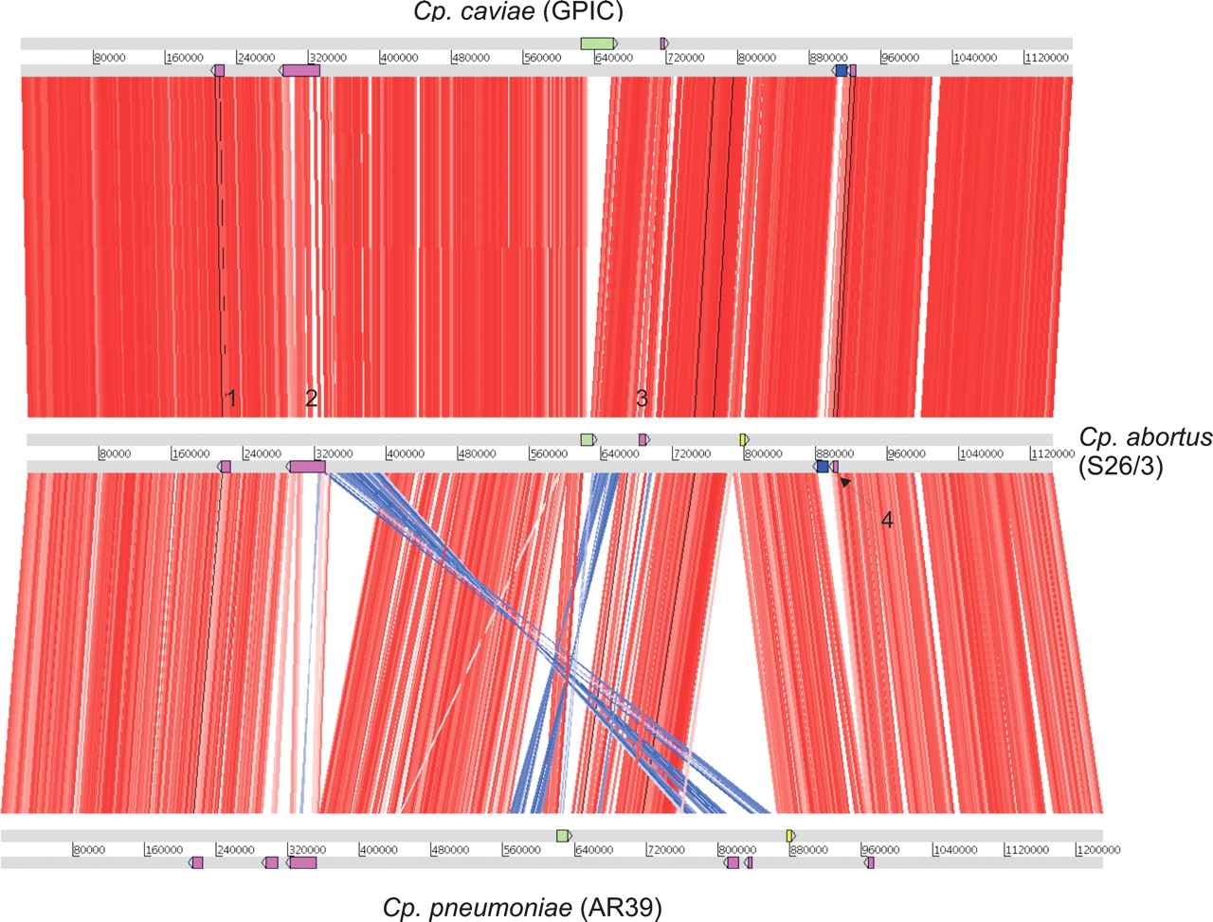
Genome-to-Genome Mappings
this is the most common way to represent relationships within genomic positions
  works when the number of cross-overs is limited
Genome Res. 2005 May;15(5):629-40

Slide 12
Genome-to-Genome Mappings
works not so well when the number of cross-overs increases

Slide 13
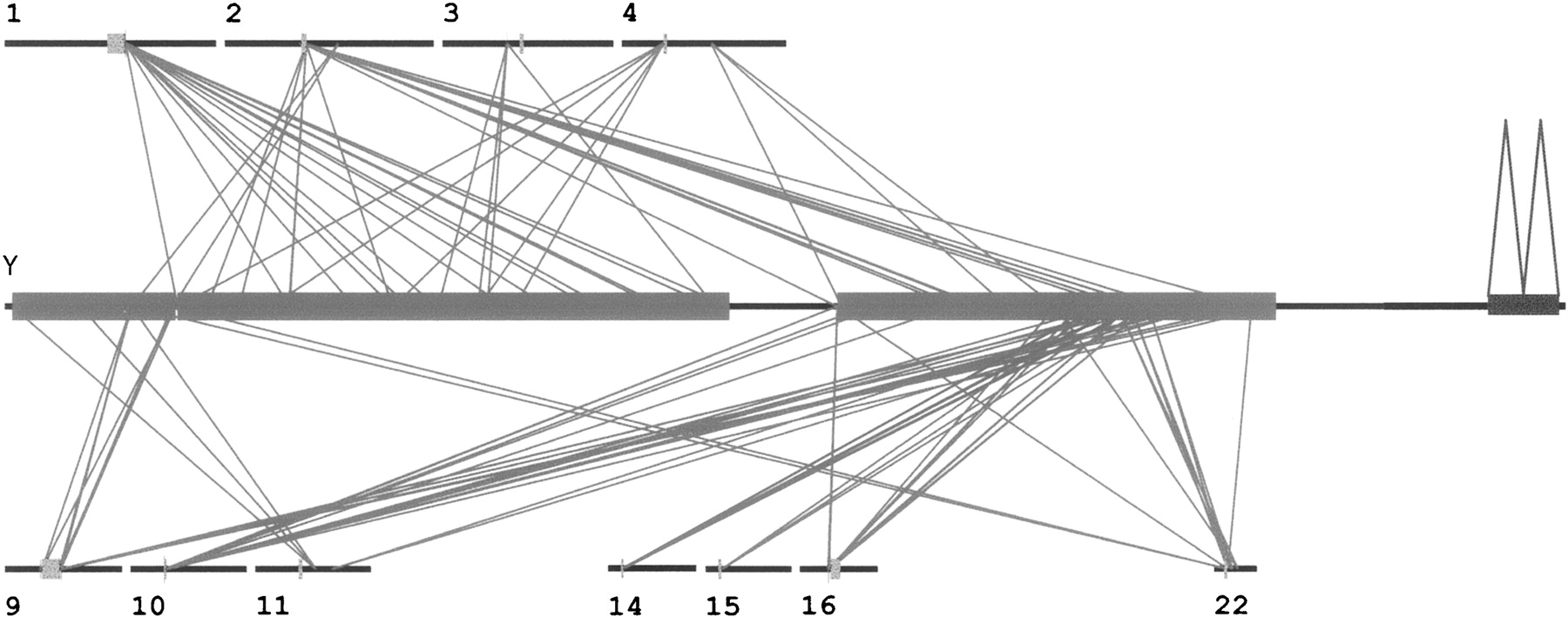
Genome-to-Genome Mappings
when complexity is increased, the figure starts to lose cohesion
  routing becomes difficult to follow
  there is no focus point for the eye – your eye wanders over the figure
Genome Res. 2003 Jan;13(1):37-45

Slide 14
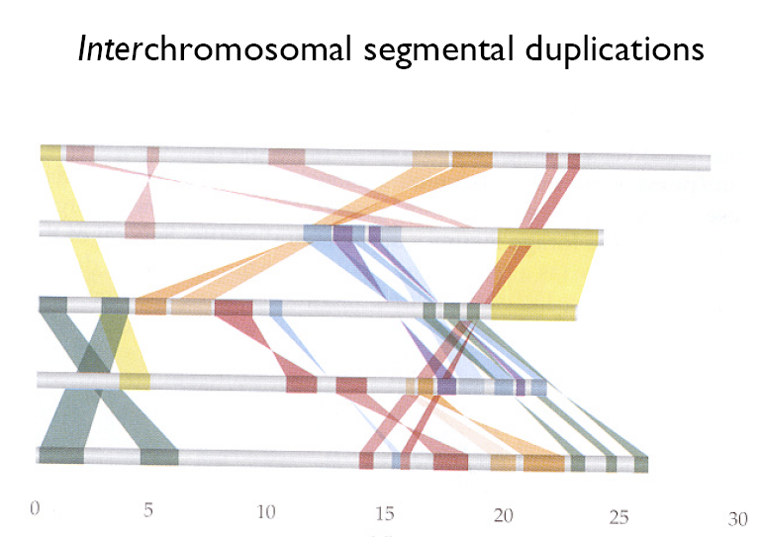
Genome-to-Genome Mappings
sometimes a little stylizing goes a long way
custom images are time-consuming to create and difficult to automate
http://www.egg.isu.edu/Members/deborah/genomics

Slide 15
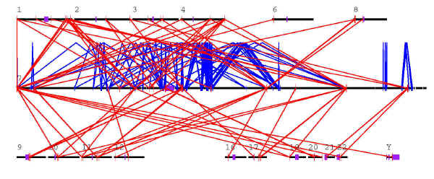
Genome-to-Genome Mappings
things get worse and worse when mappings that link both neighbouring (blue) and distant (red) positions are shown
http://www.genome.wustl.edu/projects/human/chr7paper/chr7data/030113/segmental/index.php

Slide 16
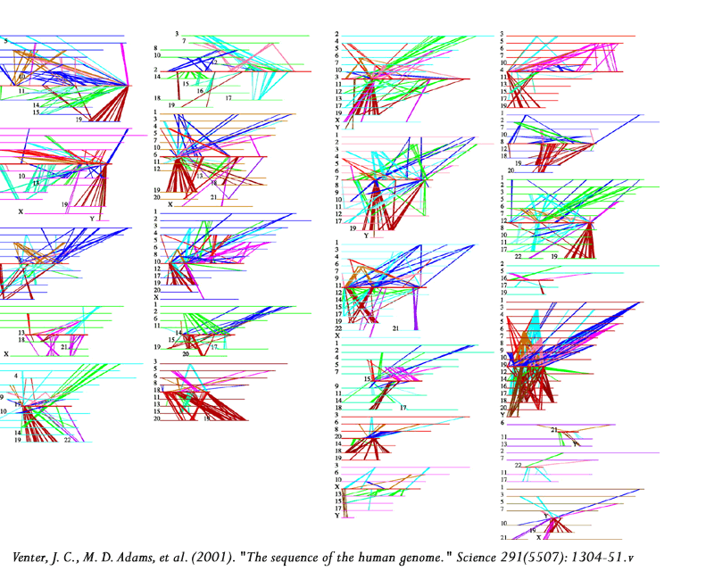
Genome-to-Genome Mappings
you can try to fix things by partitioning your data set (somehow)
mileage varies
  generally poor

Slide 17
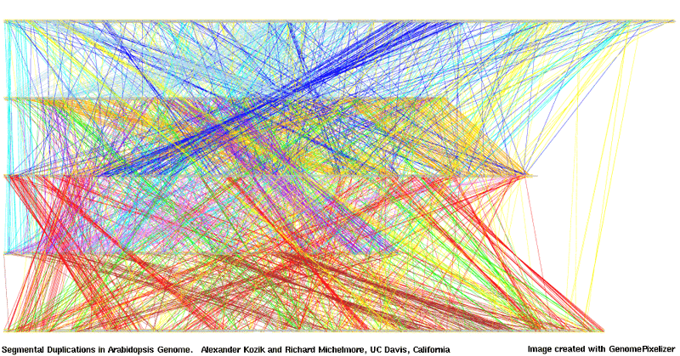
Genome-to-Genome Mappings
finally, you descend into data overload and information hell
  this is not an informative plot, although a pretty one

Slide 18
Assembly Visualization
Consed offers an assembly view
  curves are nice, but too shallow when stretching across long distances
  nice use of both sides of the axis

Slide 19
Assembly Visualization
zooming can provide more detail
  but context is lost
where do
these go?

Slide 20

What Do We Do?
work with smaller genomes
  I wish!
reduce information content in figures
  distill target genome position to a colour, based on target chromosome
UCSC Genome Browser (hg17)

Slide 21
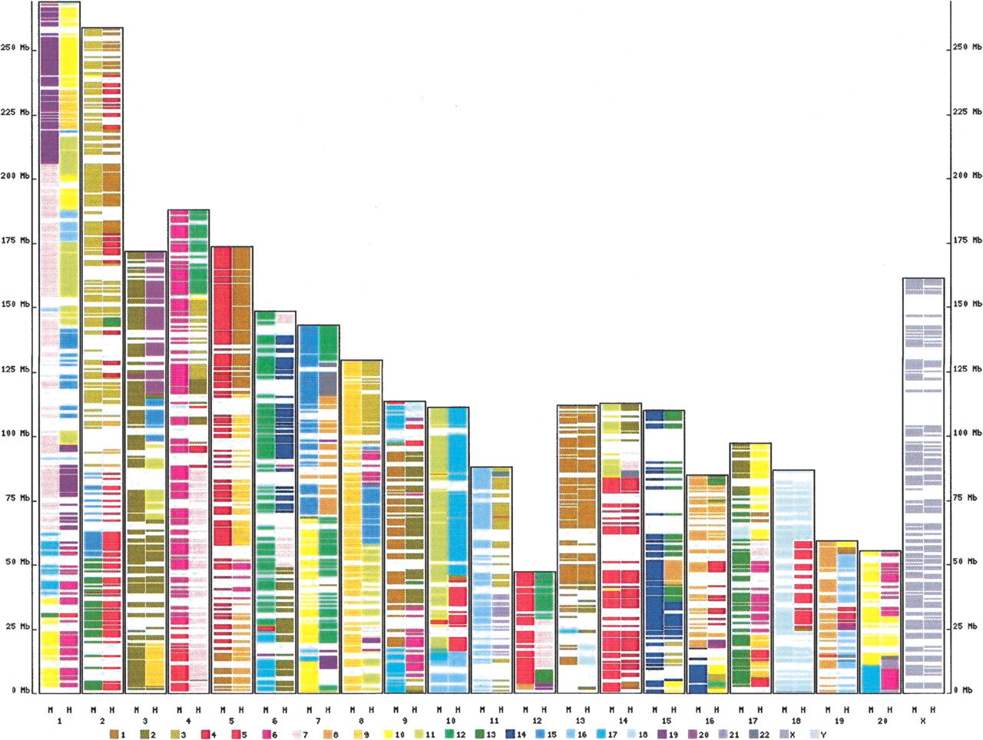
Reducing Information Content
draw the domain, colour regions in the domain by reduced representation of range
  target chromosome, by colour
genome
position
chromosome
colour scheme
convention
Genome Res. 2004 Apr;14(4):685-92

Slide 22
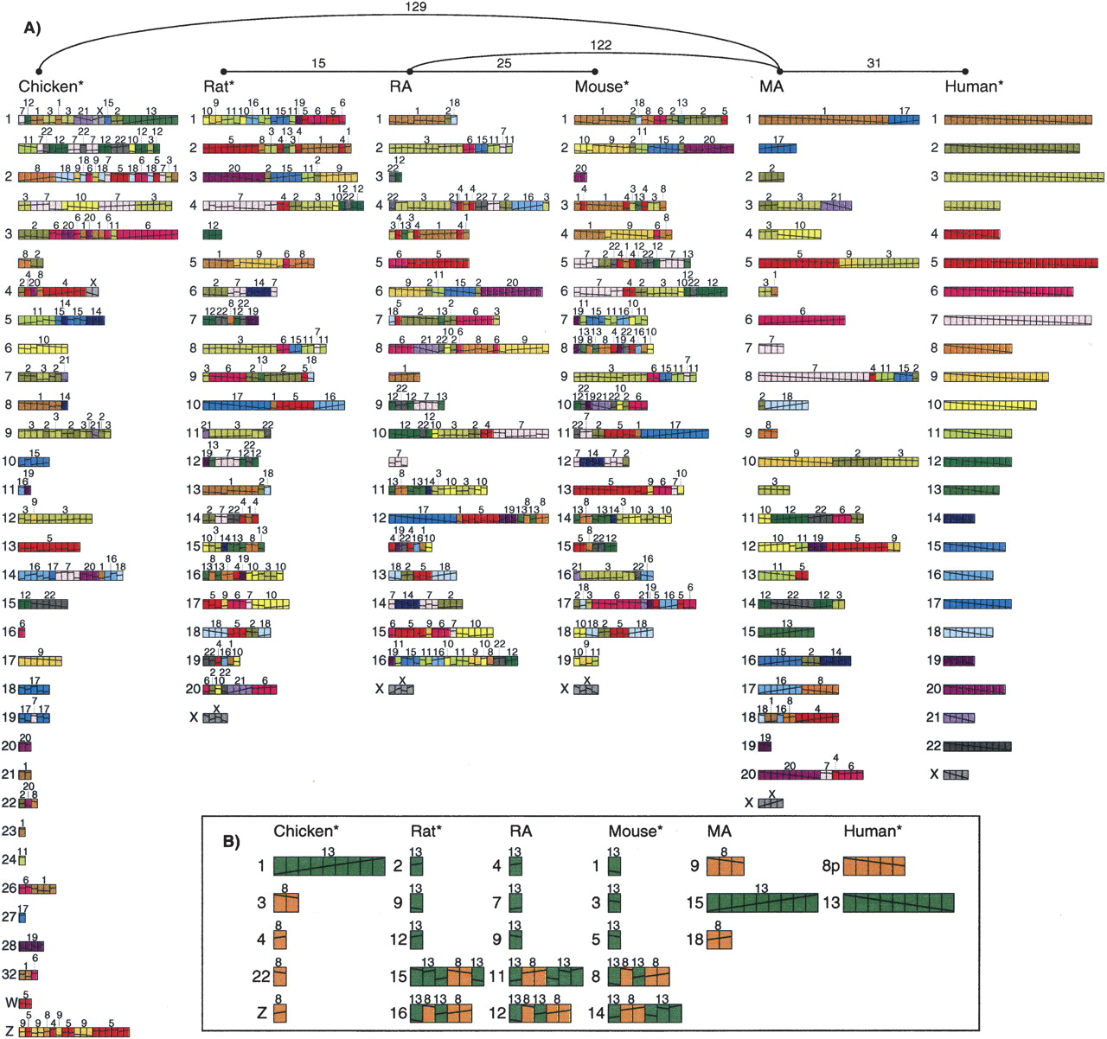
Reducing Information Content
Genome Res. 2005 Jan;15(1):98-110

Slide 23
Alter Information Layout
altering axes layout can help
  reduce cross-overs
  draw focus to regions of interest
    source/sink of lines
    deserts
however, note how the order of the peripheral chromosomes in this figure is unconventional

Slide 24

Alter Information Layout
Circos image

Slide 25
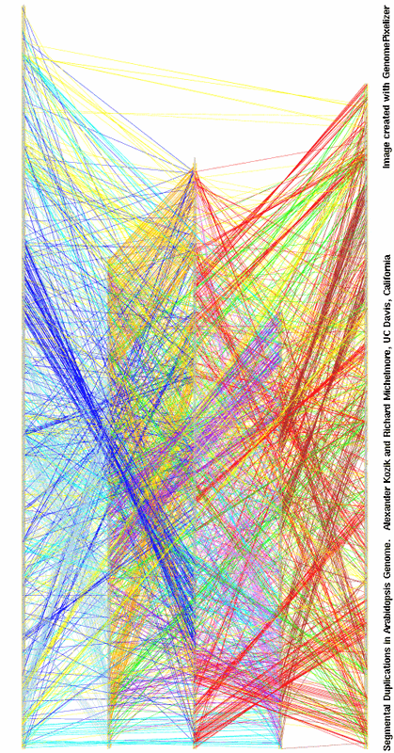
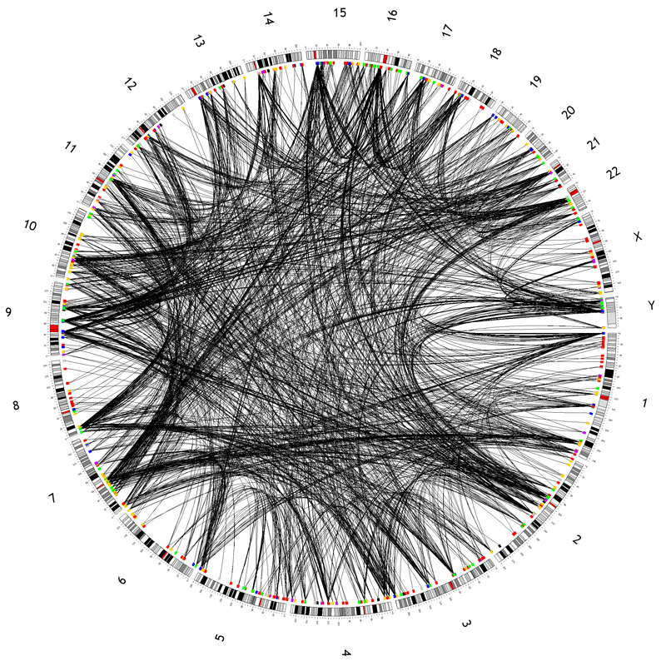
Alter Information Layout
Circos is showing
22,000 lines

Slide 26
Benefits of circular composition
sinks/sources
easy to see
sinks/sources
easy to see
interior lines make routing easy, while retaining detail
sinks/sources
easy to see

Slide 27
Winner: Circle
the circle is more symmetric than square – eye is less burdened
circle’s data payload is higher
  consider the ratio of the axis length to the data area
    for a square: 2a/4a² = 1/2a (2a = sum of x,y axes lengths)
    for a circle: 2πa/πa² = 2/a (4 times larger)
concentric tracks are more efficient
  (+) more efficient use of figure area – longer axis allows for greater spatial detail
  (-) ΔrΔϕ is not constant in area (ΔxΔy is) – shape is distorted
genome axis
DATA HERE
DATA HERE
2a
a
genome axis
genome axis
DATA HERE

Slide 28
Circos
Perl
graphics by GD (API to gd graphics library)
Apache-like configuration file
mkweb.bcgsc.ca/circos
features
  generalized concentric data tracks
    line, scatter, histogram
    clone tiles
    mappings
      dynamic geometry/line property rules
  non-linear scale
    regions can be locally zoomed without cropping
  full user control over aspects of all elements
    colour, thickness, stroke, etc

Slide 29
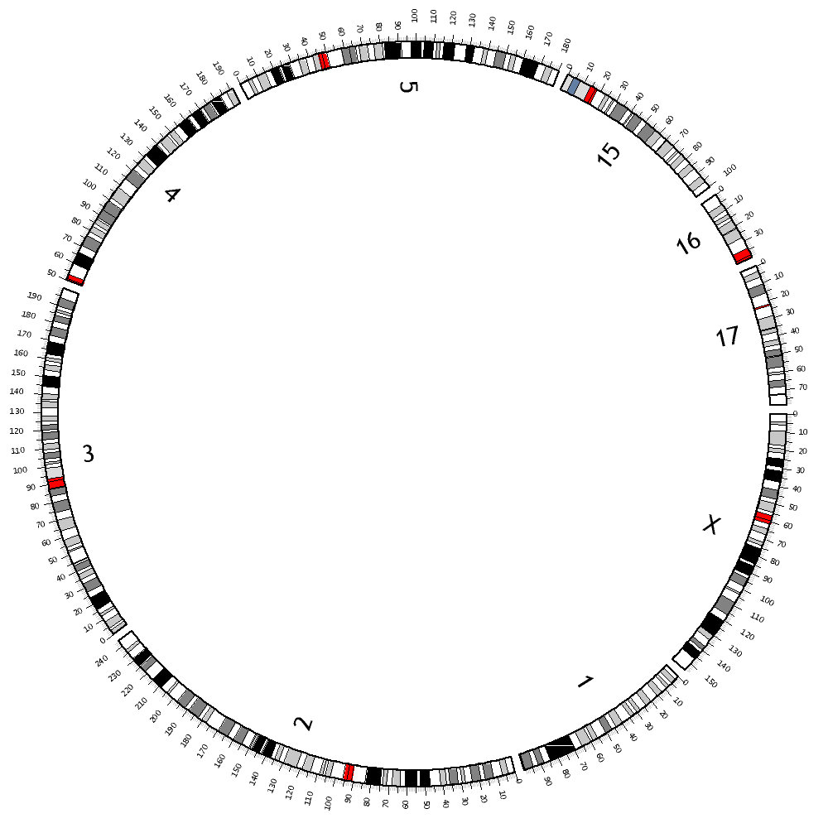
Circular Axis
start with objects that have a distance scale
  chromosome
  contig
  sequence
  map
place objects around the circle
  order can be optimized for better routing
superimpose data tracks

Slide 30
Configuration File
<colors>
<<include ../etc/colors.conf>>
</colors>
karyotype = ../data/karyotype_hg17.txt
outputdir = /home/martink/www/htdocs/circos/tutorial/001
outputfile = 4.gif
radius = 500
chrspacing = 5e6
chrthickness = 20
chrstroke = 2
chrcolor = black
chrradius = 0.9
chrlabel = yes
chrlabelradius = 0.75
chrlabelsize = 24
bandstroke = 1
showbands = yes
fillbands = yes
chromosomes = 1:0-100000000,2,3,4:50000000-,5,15,16:-40000000,17,X
chrticklabels = yes
tickmultiplier = 1e-6
tickradiusoffset = 0.0
gridoffset = 0
gridstart = 0.55
<ticks>
<tick>
spacing = 1000000
size = 5
thickness = 1
color = grey
label = no
labelsize = 12
format = %d
grid = no
</tick>
<tick>
spacing = 5000000
size = 7
thickness = 1
color = black
label = no
labelsize = 6
format = %.1f
grid = no
gridcolor = grey
</tick>
<tick>
spacing = 10000000
size = 10
thickness = 1
color = black
label = yes
labelsize = 8
format = %d
grid = no
gridcolor = dgrey
</tick>
</ticks>

Slide 31
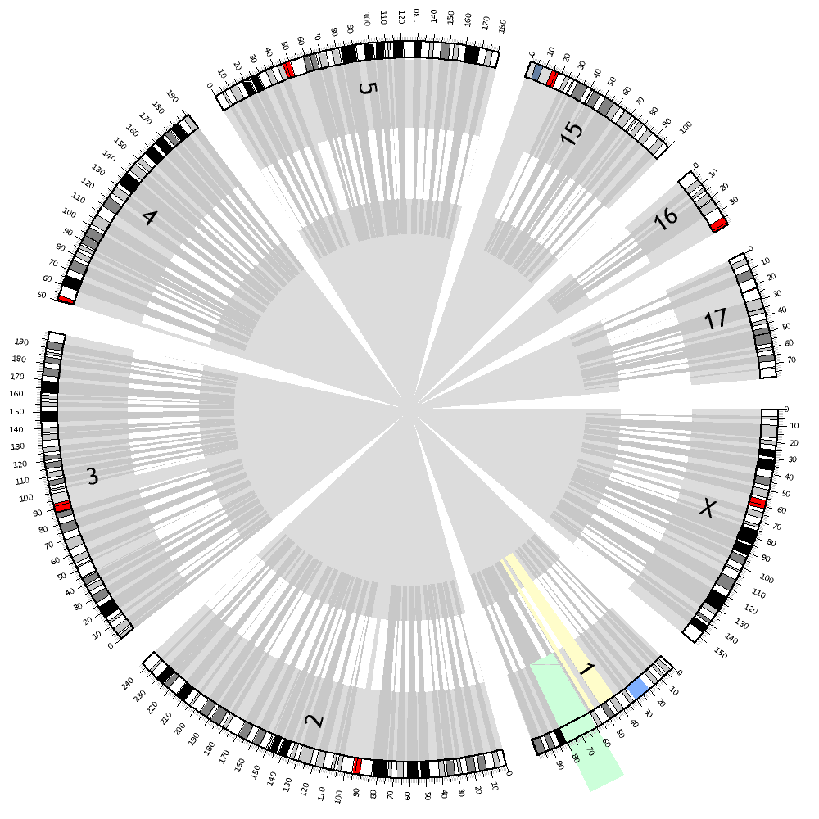
Highlights
you can highlight regions by creating coloured slices
  order of layering controlled by z-level for each element
  highlights sit in the back, under all other elements

Slide 32
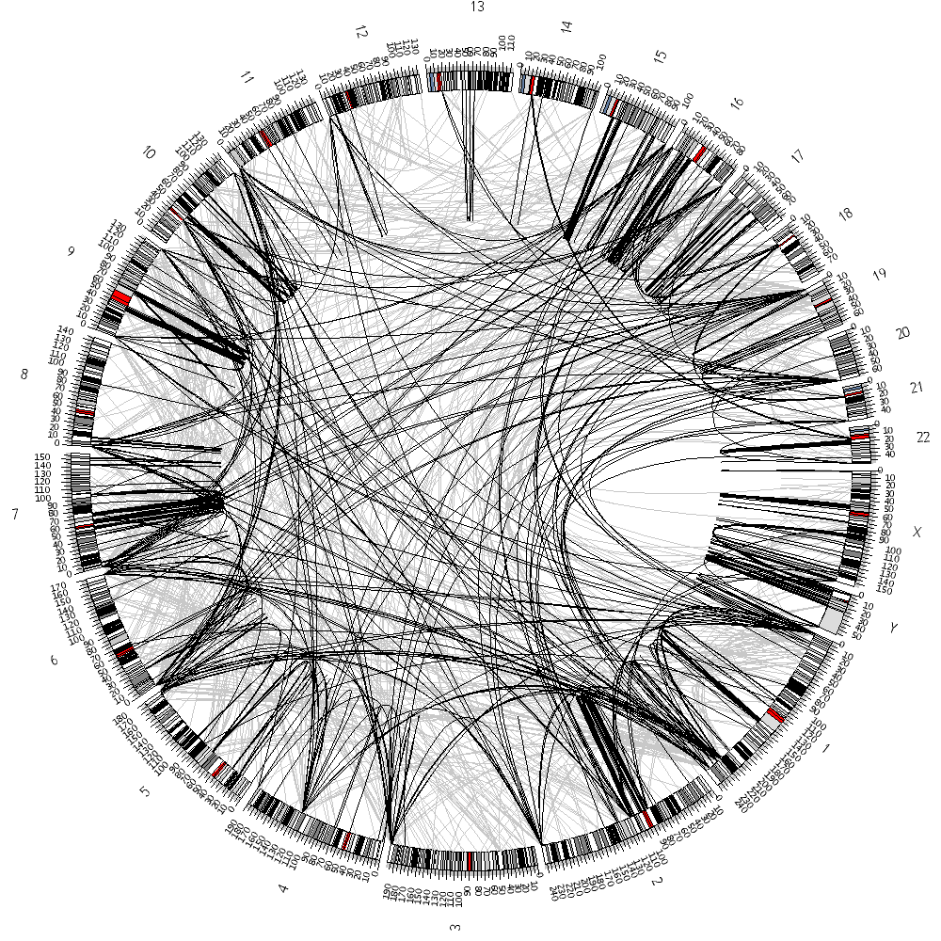
Genome-to-Genome Mappings
# in configuration file
<links segdup>
show = yes
color = black
thickness = 1
offset = 0
bezierradius = 0.3
file = segdups.txt
</links>
# segdups.txt format
# ID chr1 pos11 pos12
# ID chr2 pos21 pos22
. . .
segdup10133 13 17975618 17981753
segdup10133 4 131149507 131155638
segdup10148 4 131149510 131152617
segdup10148 4 131156685 131159786
segdup10156 1 143389520 143392018
segdup10156 4 131156687 131159175
segdup10161 13 17989958 17991102
segdup10161 4 131158639 131159786
. . .

Slide 33
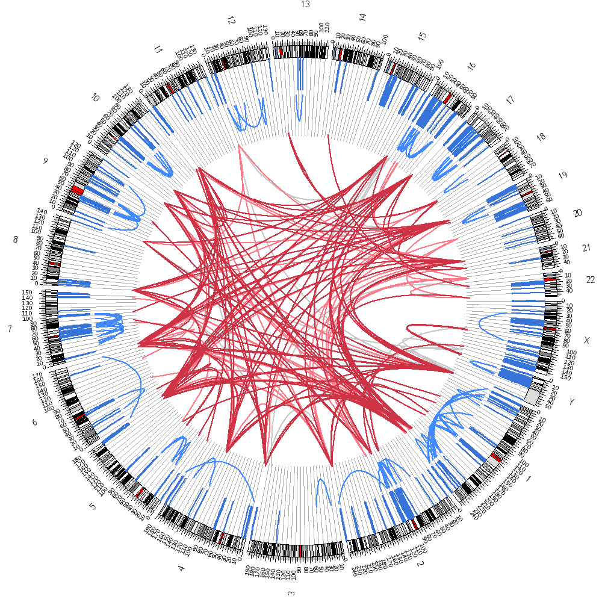
Formatting Rules
<links segdup98>
show = yes
color = grey
thickness = 2
offset = 0
bezierradius = 0.2
file = segdups.txt
z = 0
<rule link>
FORMATTING RULE
</rule>
. . .
<rule link>
FORMATTING RULE
</rule>
</links>

Slide 34
Formatting Rules
1
rule = '_CHR1_' eq '_CHR2_' && abs(_POS1_-_POS2_) < 10000000
color = blue
bezierradius = 0.7
rule = '_CHR1_' eq '_CHR2_' && abs(_POS1_-_POS2_) >= 10000000
color = lblue
offset = 0.125
bezierradius = 0.6
rule = '_CHR1_' ne '_CHR2_' && min(_SIZE1_,_SIZE2_) >= 25000
offset = 0.25
color = dred
z = 10
importance = 20
rule = '_CHR1_' ne '_CHR2_' && min(_SIZE1_,_SIZE2_) > 10000
offset = 0.25
color = lred
z = 7
importance = 10
rule = '_CHR1_' ne '_CHR2_' && min(_SIZE1_,_SIZE2_) > 5000
offset = 0.25
color = grey
importance = 5
z = 5
rule = '_CHR1_' ne '_CHR2_'
offset = 0.25
color = vlred
z = 5
hide = yes
2
3
1
2
4
3 - 6
5
6

Slide 35
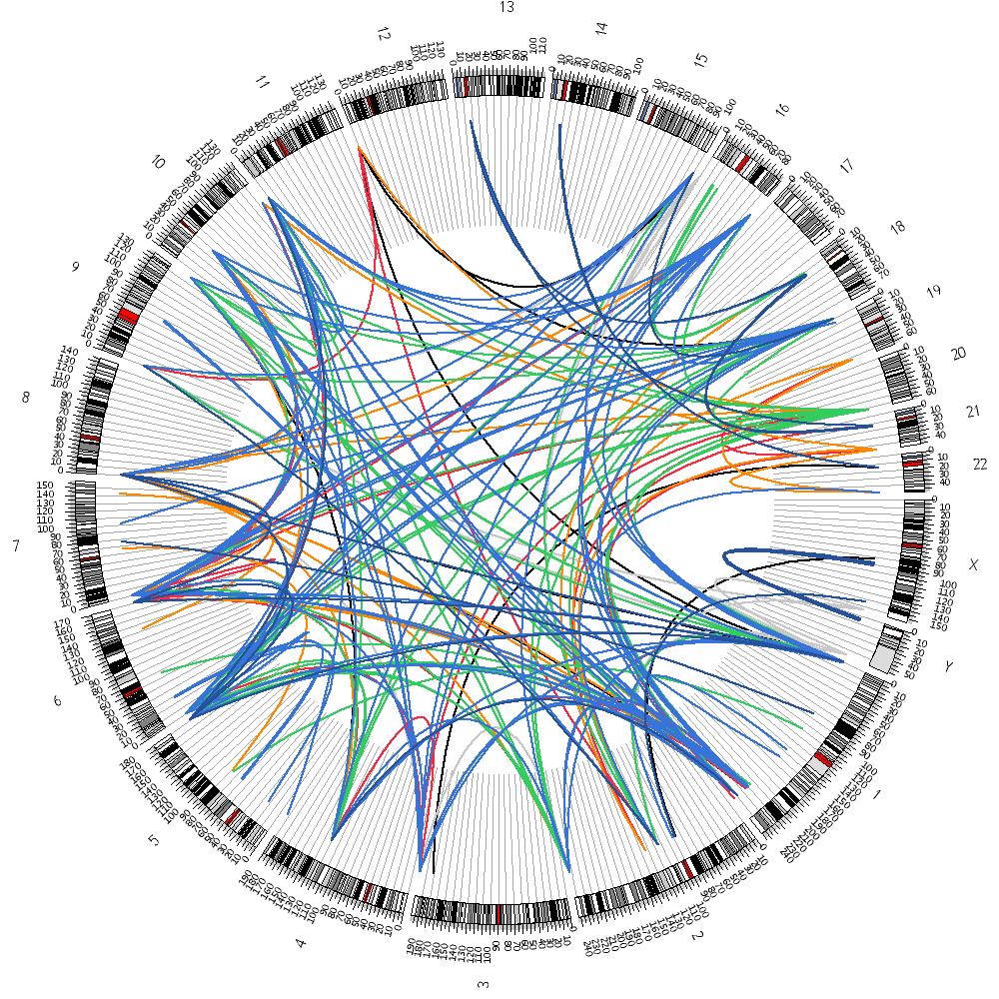
Formatting Rules
<rule link>
importance = 100
rule = '_CHR1_' eq '_CHR2_'
hide = yes
</rule>
<rule link>
importance = 100
rule = '_CHR1_' ne '_CHR2_' && min(_SIZE1_,_SIZE2_) < 5000
hide = yes
</rule>
<rule link>
importance = 90
rule = '_CHR1_' ne '_CHR2_' && min(_SIZE1_,_SIZE2_) < 7500
color = black
z = 0
</rule>
<rule link>
importance = 85
rule = '_CHR1_' ne '_CHR2_' && min(_SIZE1_,_SIZE2_) < 10000
color = grey
z = 5
</rule>
<rule link>
importance = 80
rule = '_CHR1_' ne '_CHR2_' && min(_SIZE1_,_SIZE2_) < 15000
color = red
z = 10
</rule>
<rule link>
importance = 75
rule = '_CHR1_' ne '_CHR2_' && min(_SIZE1_,_SIZE2_) < 20000
color = orange
z = 15
</rule>
. . .

Slide 36
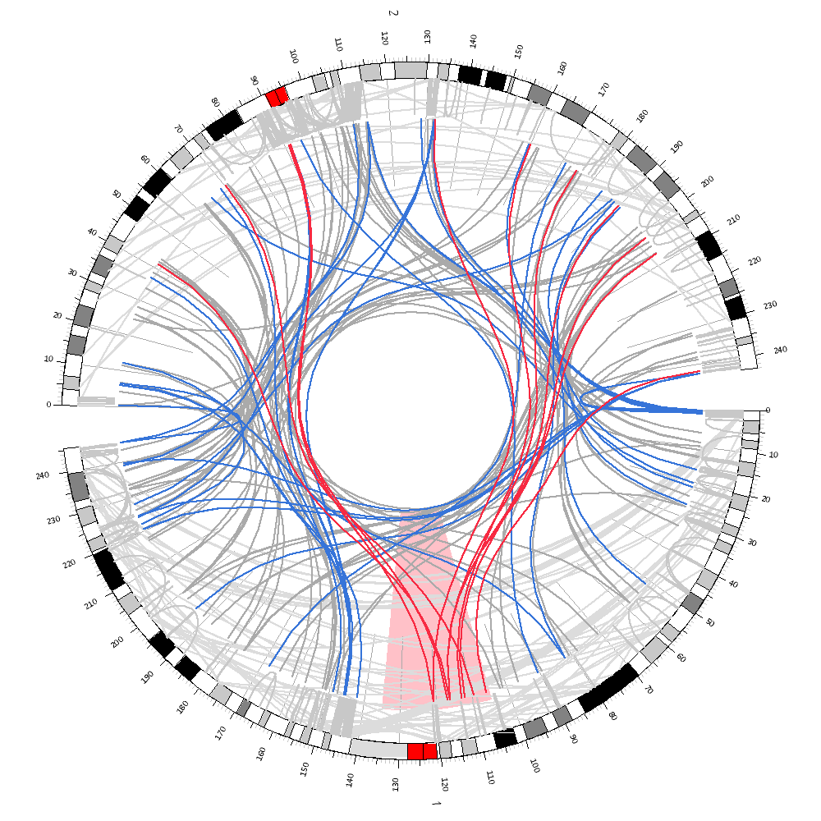
Formatting Rules
<rule link>
importance = 100
rule = '_CHR1_' eq '_CHR2_'
&& abs(_POS1_-_POS2_) < 20000000
bezierradius = 0.8
crest = 0.1
color = grey
offset = 0
z = -10
</rule>
<rule link>
importance = 100
rule = '_CHR1_' eq '_CHR2_'
&& abs(_POS1_-_POS2_) >= 20000000
bezierradius = 0.9
crest = 0
color = lgrey
offset = 0
z = -20
</rule>
<rule link>
importance = 90
rule = _CHR1_ eq "1"
&& abs(_POS1_ - 120000000) < 15000000
color = red
z = 15
</rule>
<rule link>
importance = 80
rule = min(_SIZE1_,_SIZE2_) < 2000
color = dgrey
z = -5
</rule>
1
1
2
blue
default
2
3
4
3
4

Slide 37
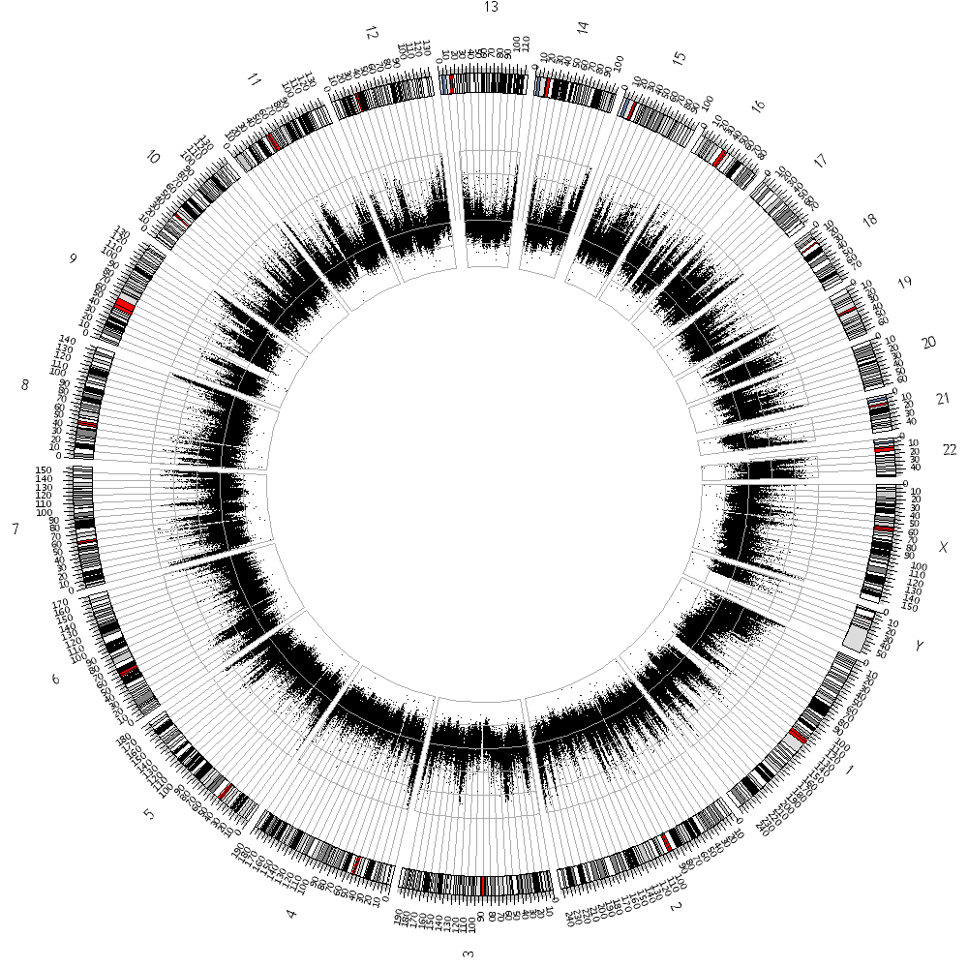
2D Plots
<plots>
<plot>
<data>
file = gc.txt
size = 1
color = black
type = scatter
glyph = circle
</data>
orientation = out
offset = -0.2
height = 120
min = 20
max = 70
yspacing = 10
axes = yes
axescolor = dgrey
</plot>
</plots>

Slide 38
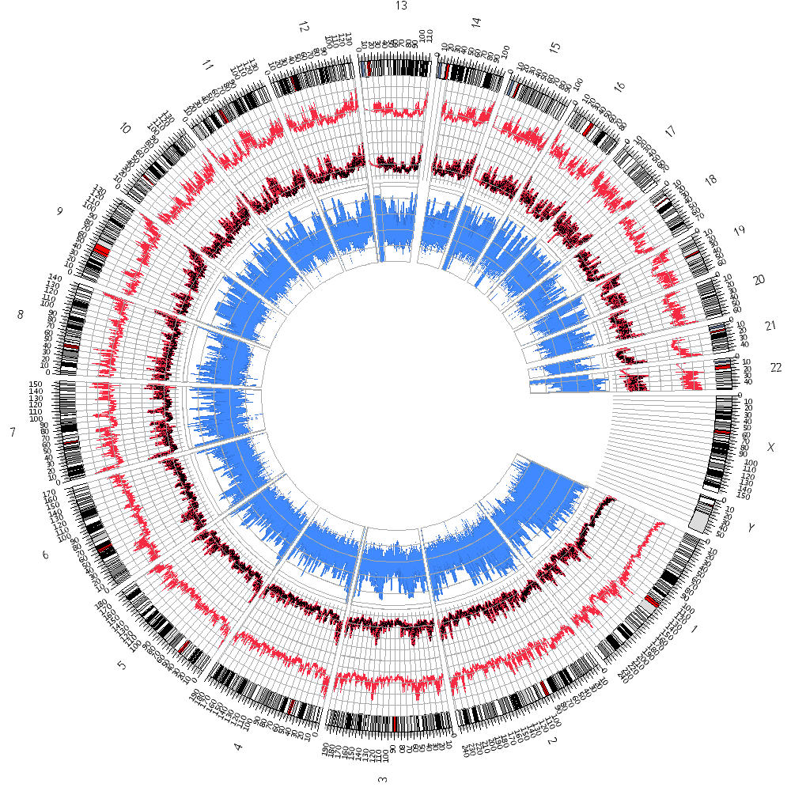
2D Plots

Slide 39
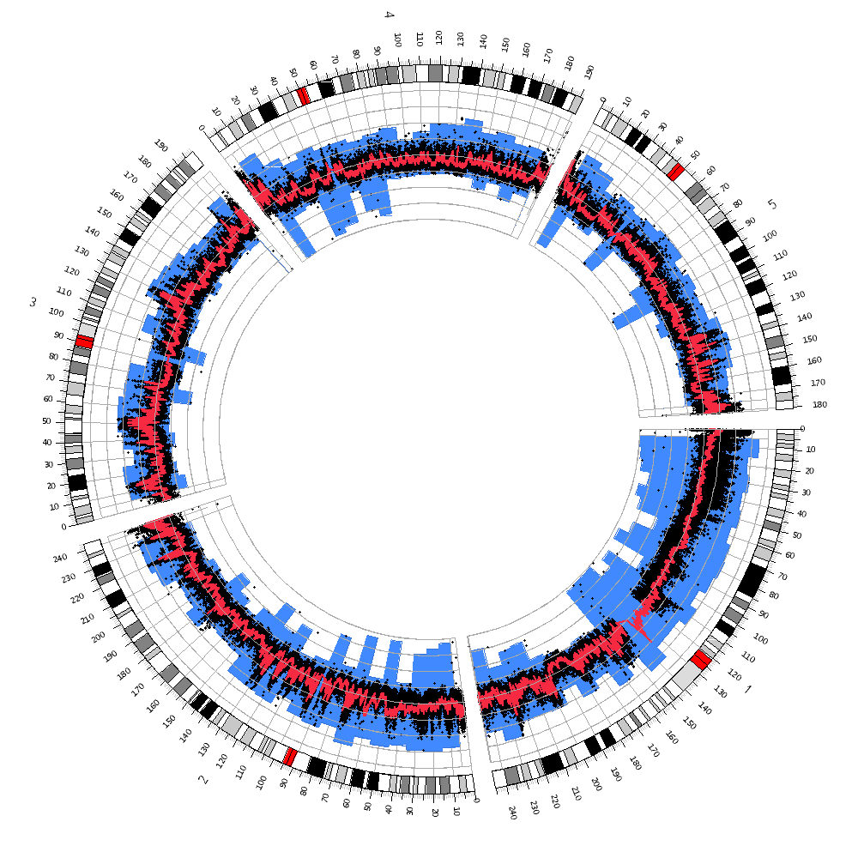
2D Plots
box
scatter
line

Slide 40
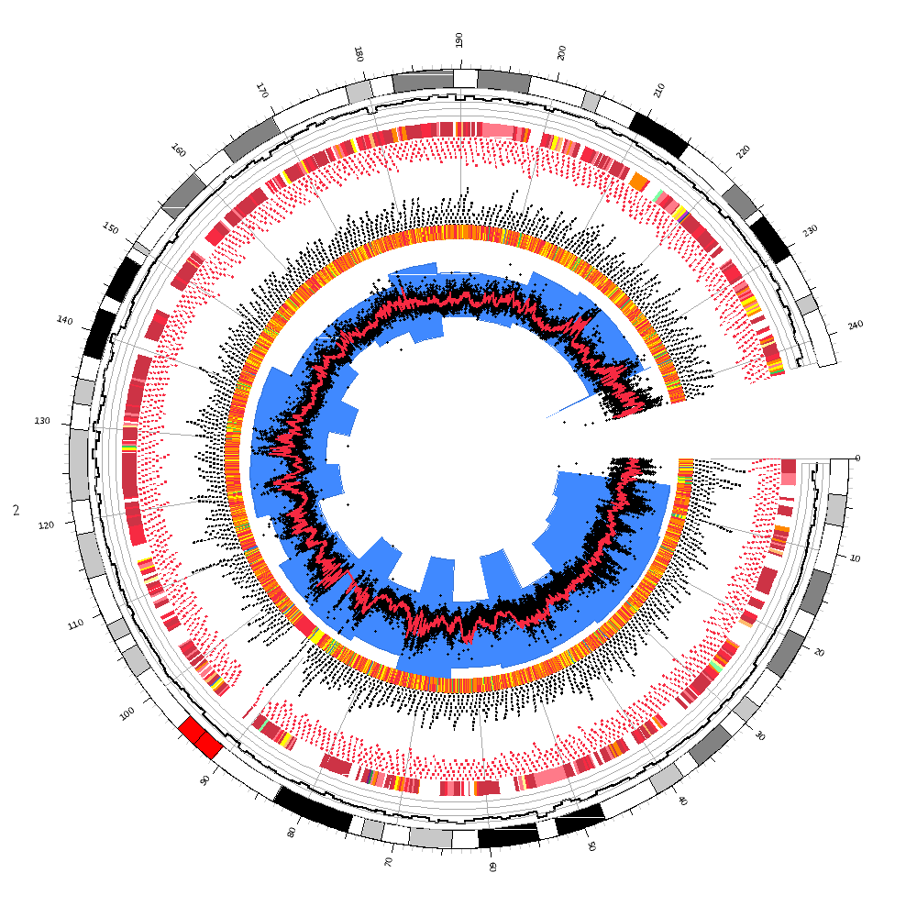
2D Plots
tiles
tiles
histogram
heatmaps
chr2

Slide 41
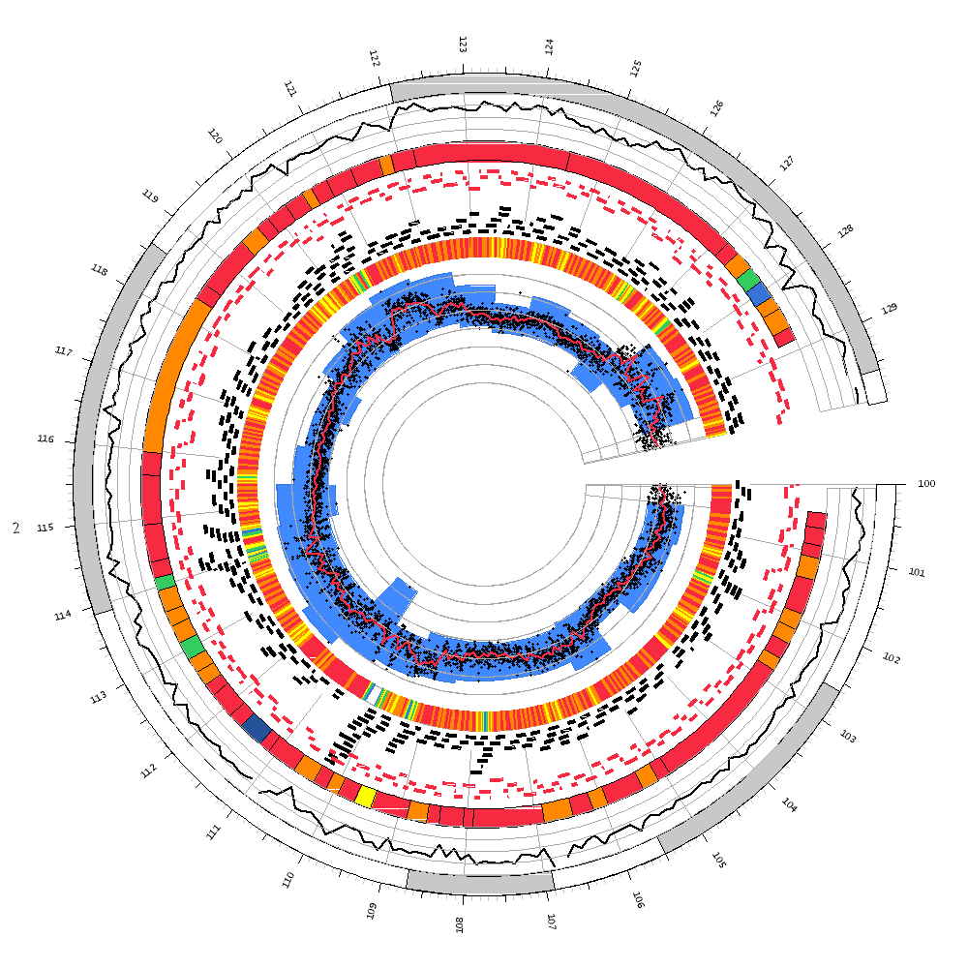
2D Plots
30 Mb on chr2

Slide 42
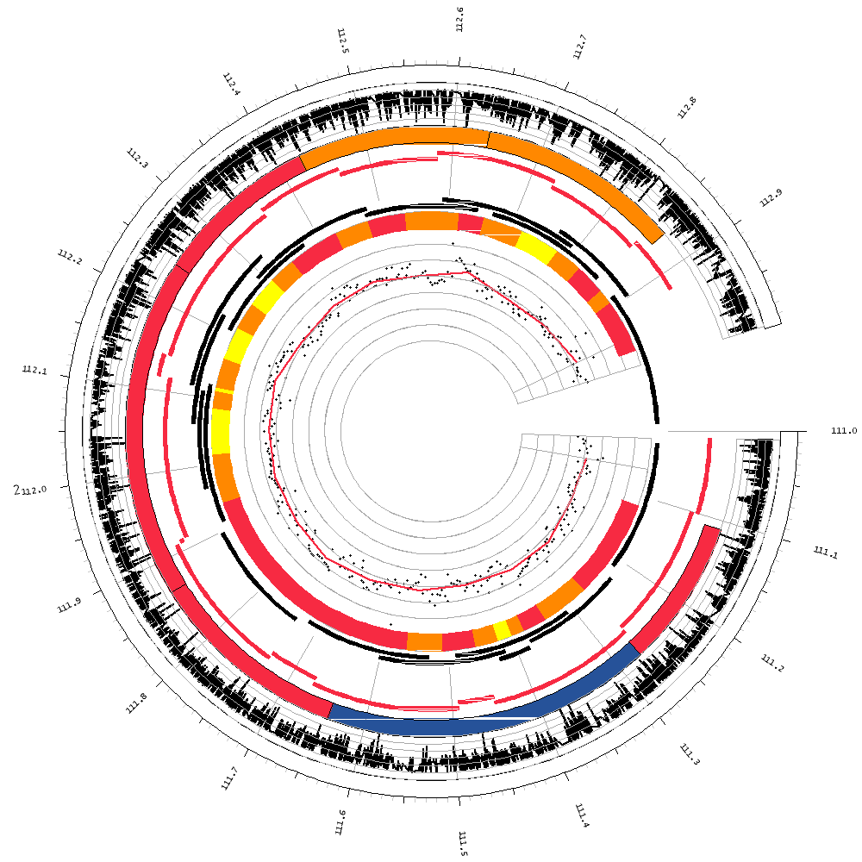
2D Plots
2 Mb on chr2

Slide 43
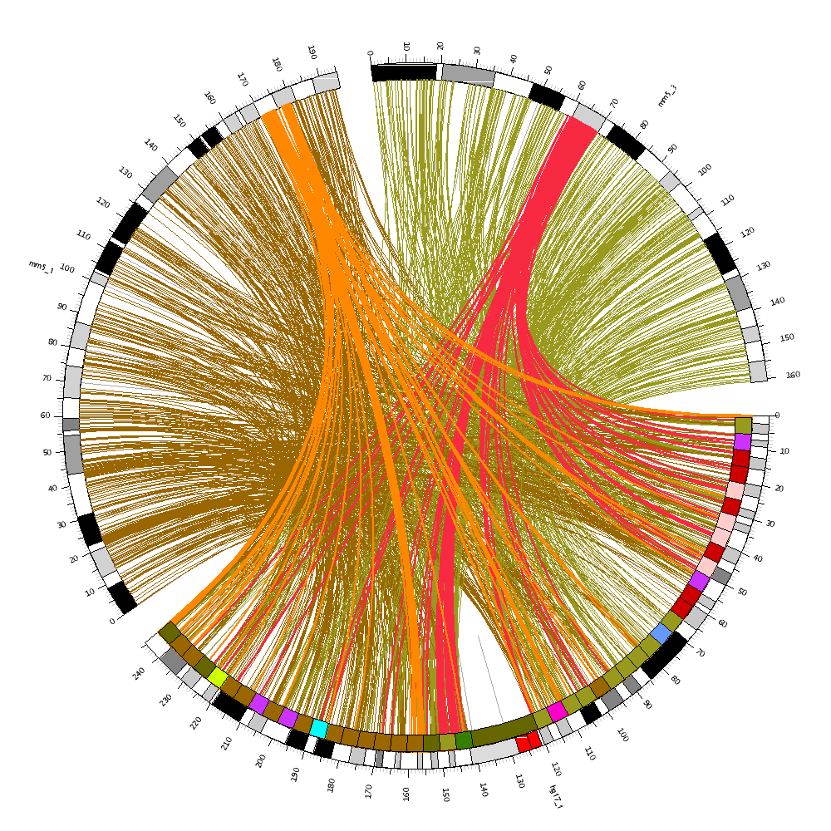
Applications
mouse chr3
mouse chr1
human chr1

Slide 44
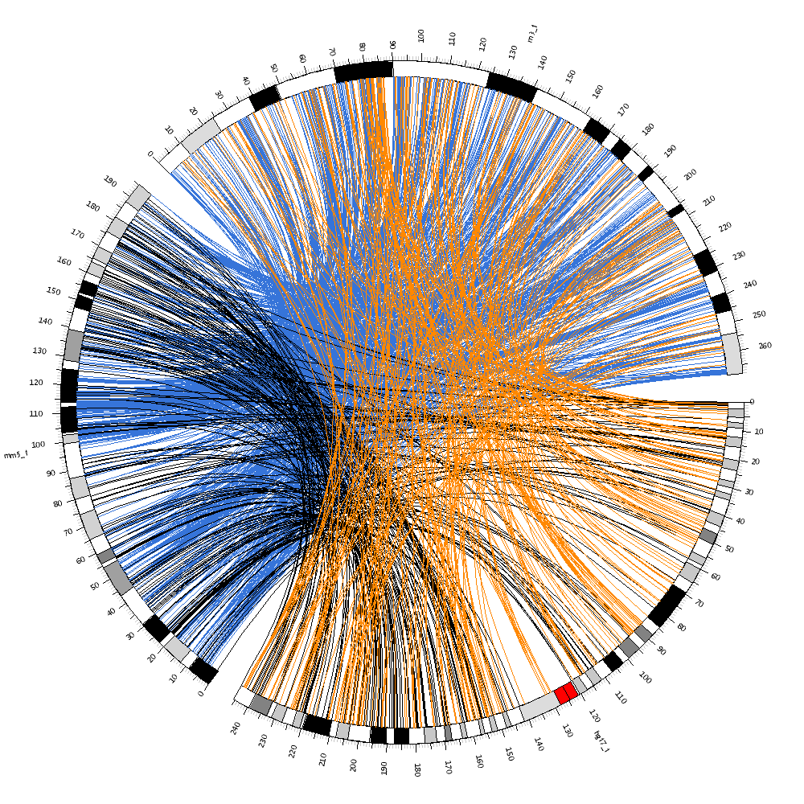
Applications
rat chr1
mouse chr1
human chr1

Slide 45
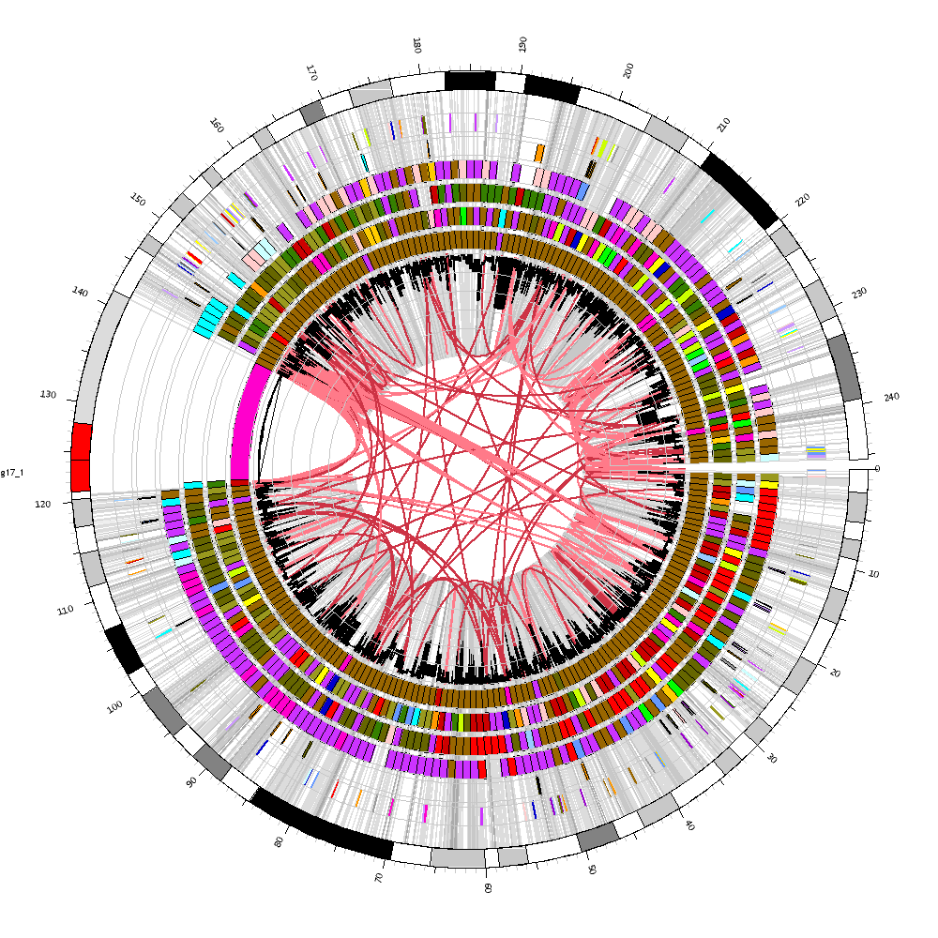
Applications
heat maps show conservation between human and
chimp (inner)
mouse
rat
dog
chicken
zebrafish (outer)

Slide 46
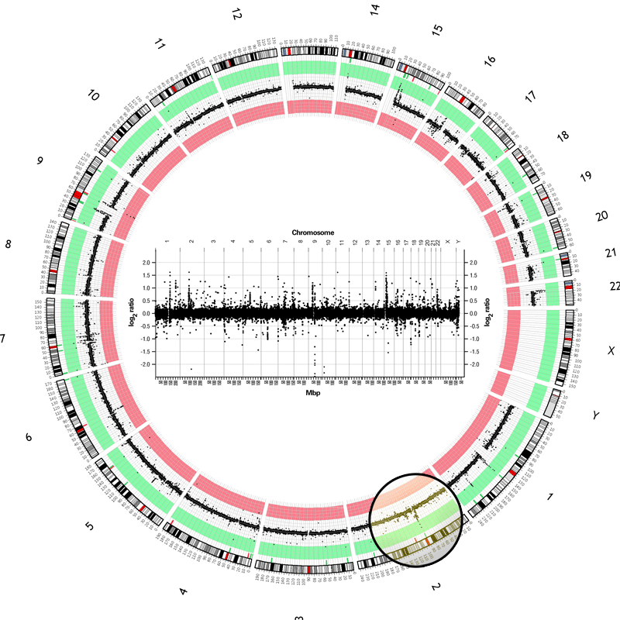
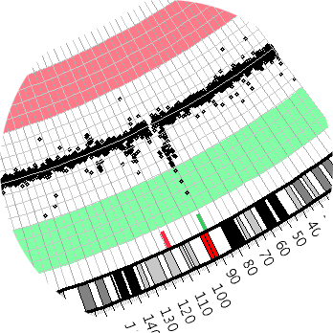
Applications

Slide 47
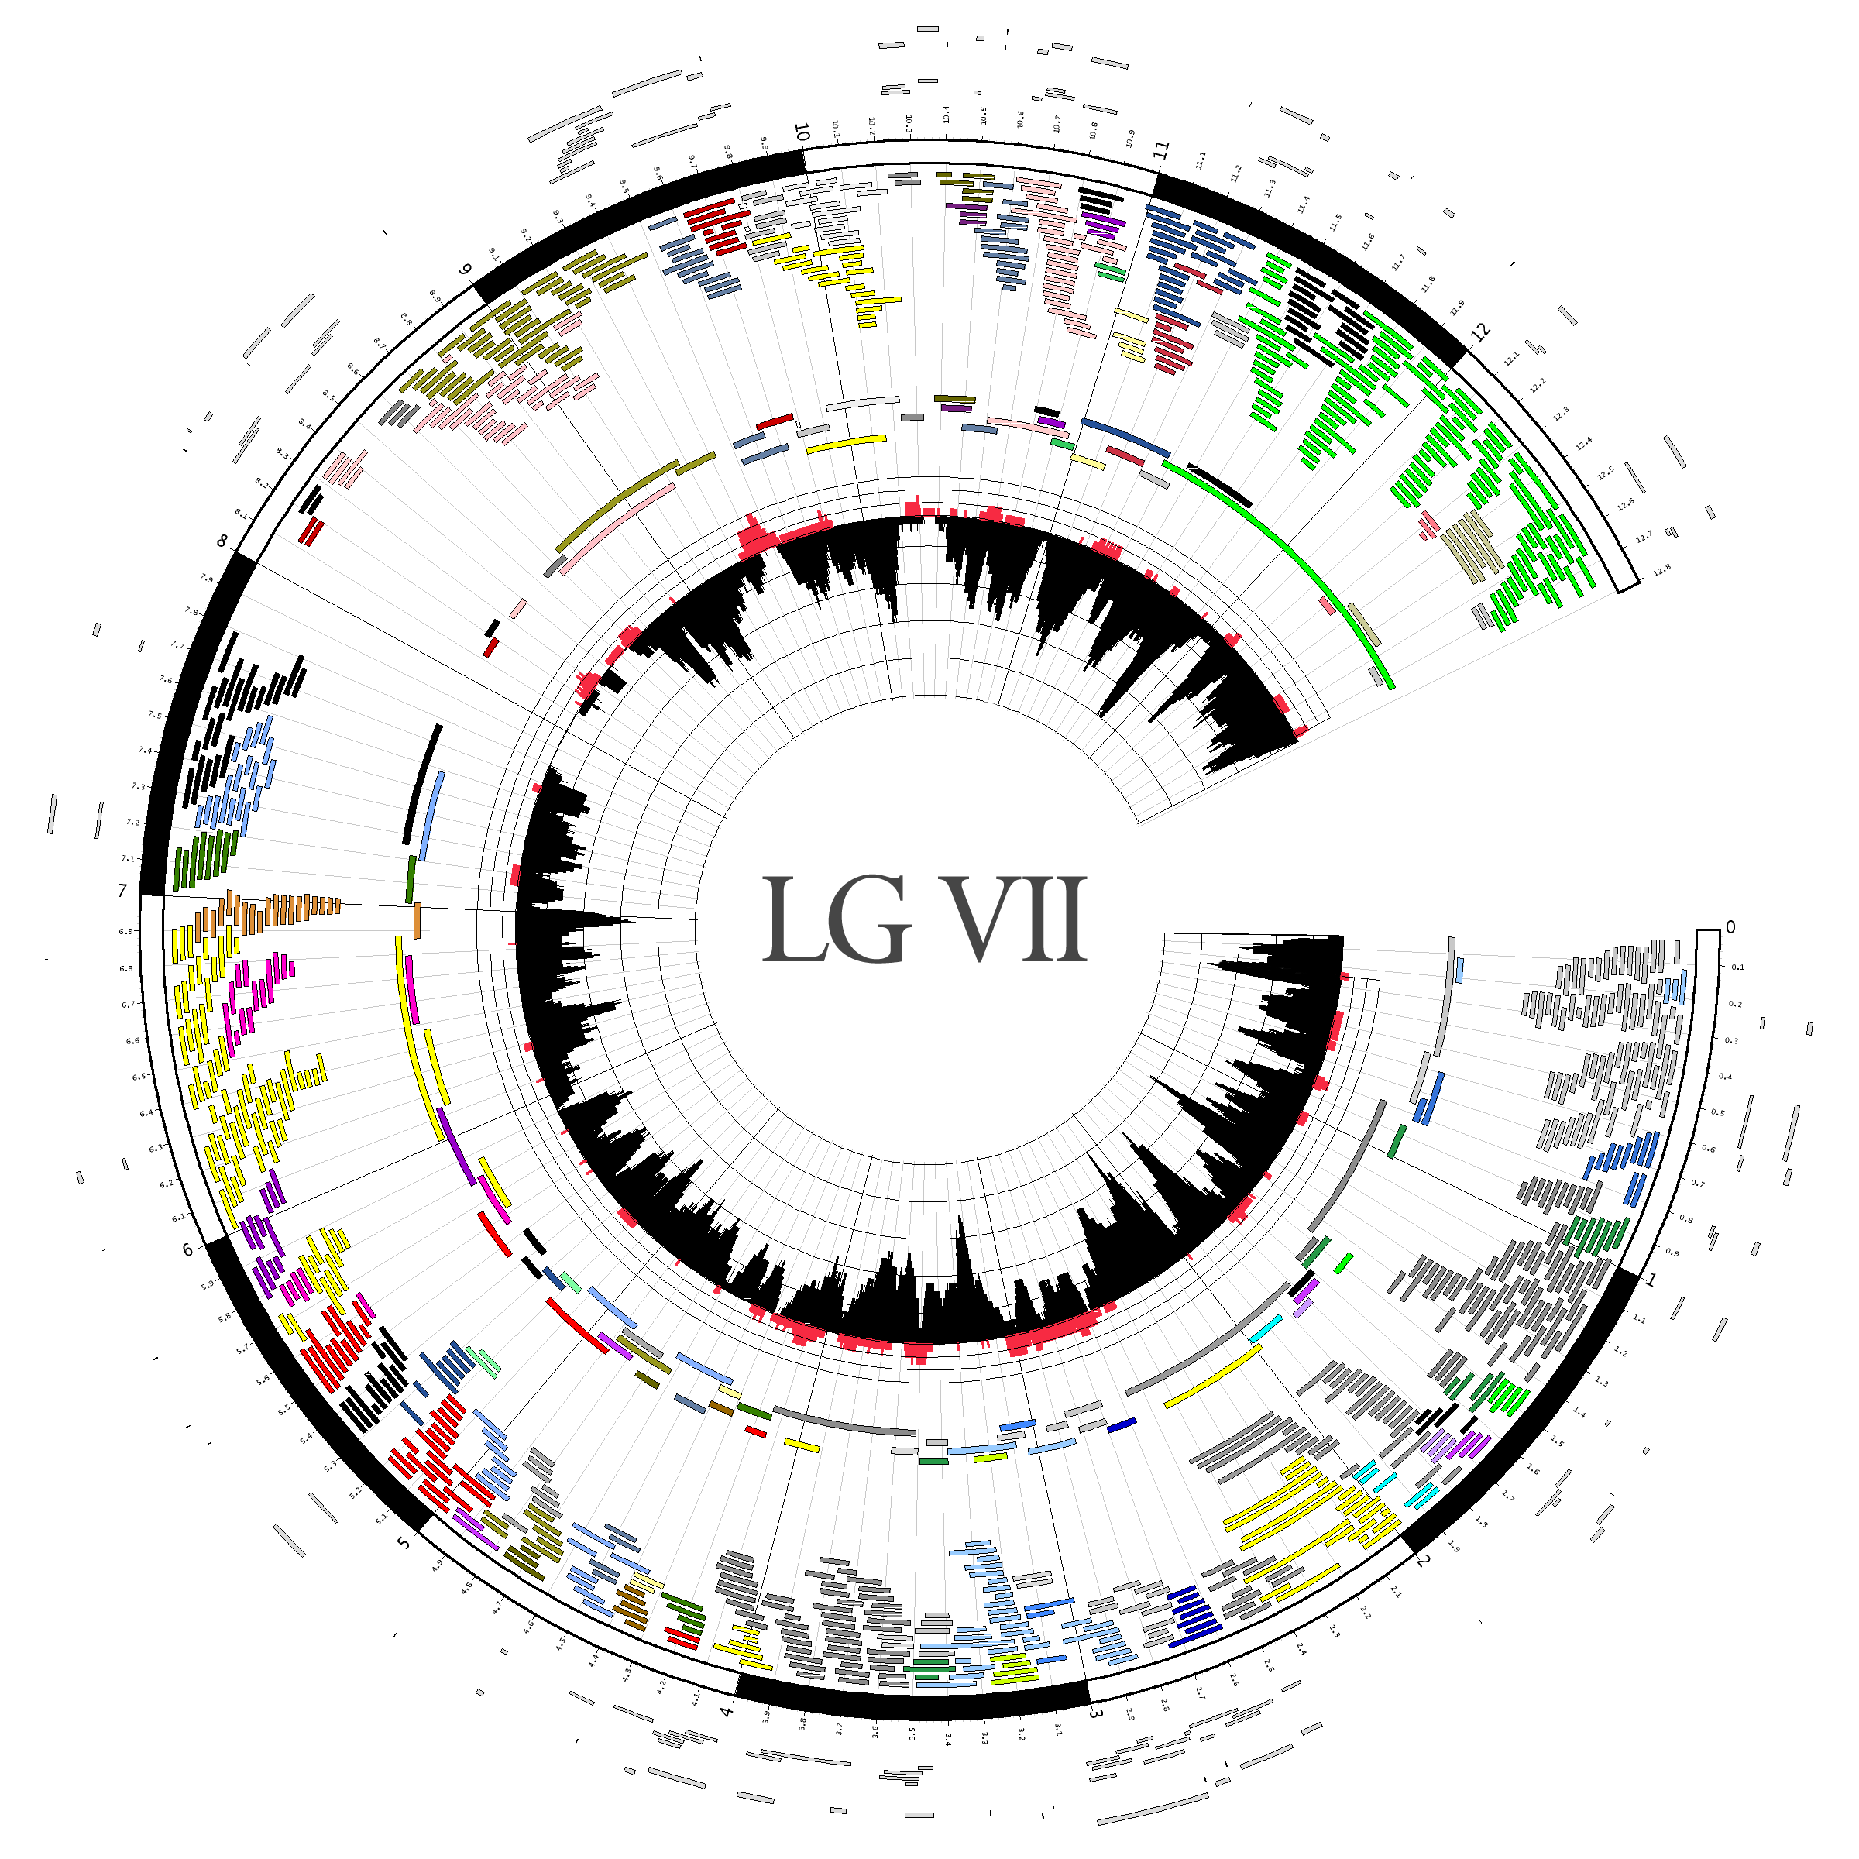
Applications

Slide 48
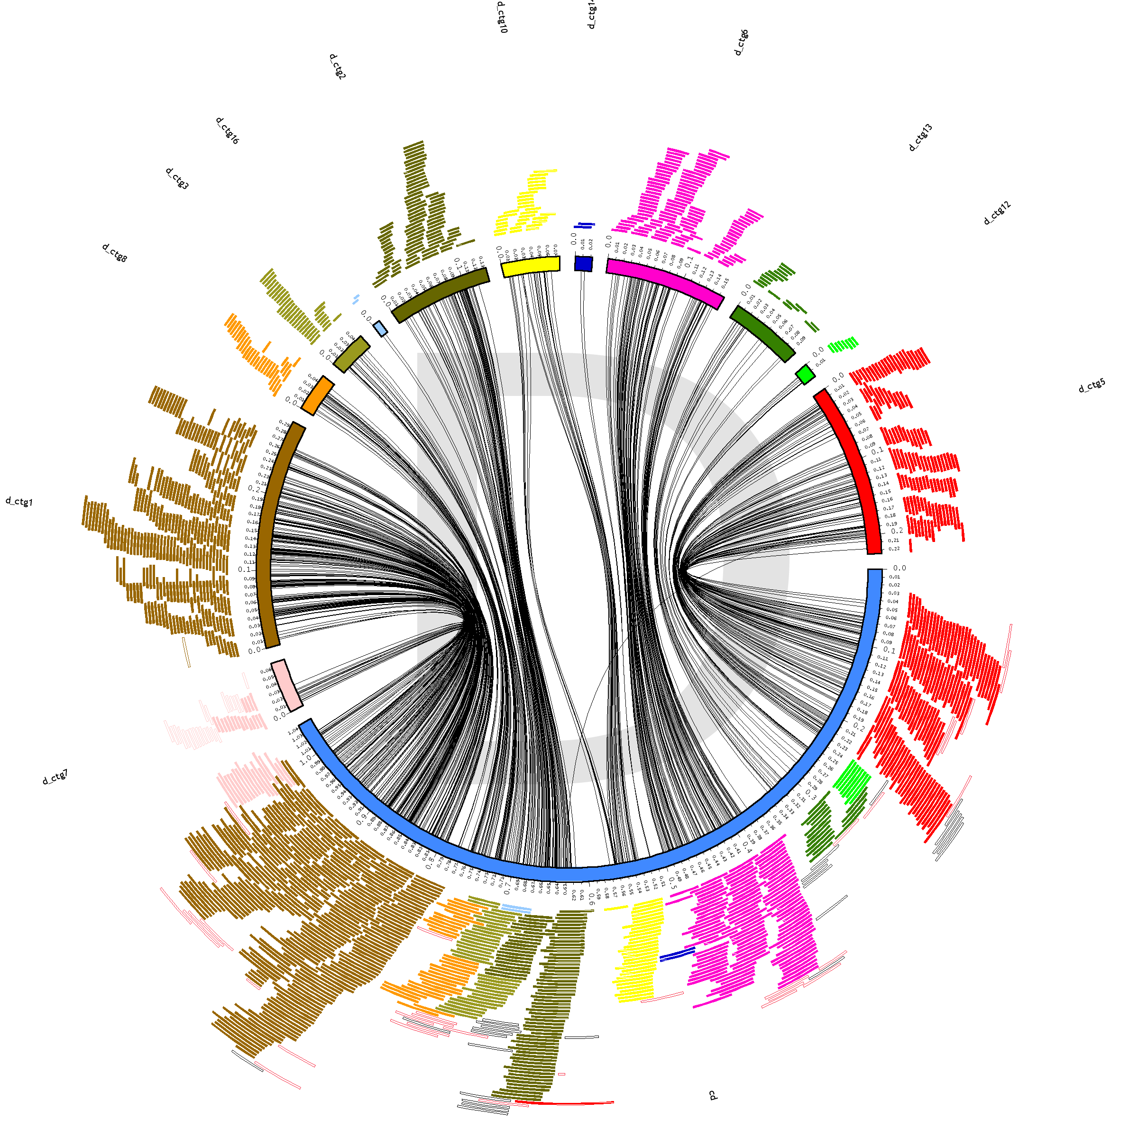
Applications
chlamydia D fingerprint map contigs
fingerprint map clones localized on assembly by end sequence
circle contains two independent entities: fingerprint map and assembly
  lines join a clone’s position in the map and in the sequence
lack of cross-overs indicates consistency between map and sequence
  map contigs ordered to minimize cross-over
chlamydia D sequence

Slide 49
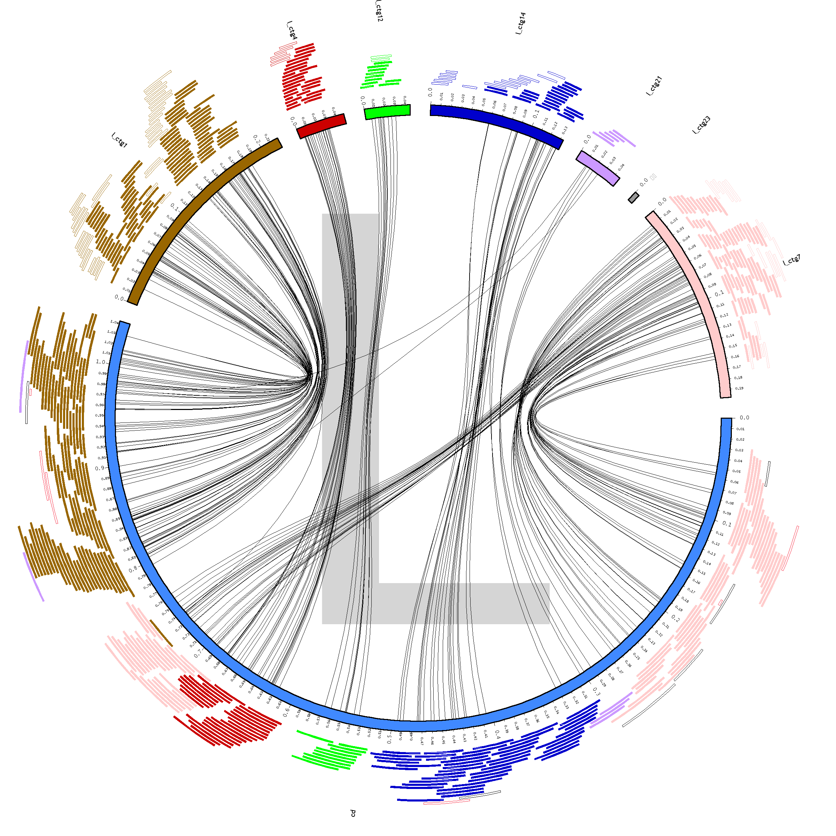
Applications
chlamydia L fingerprint map
chlamydia D sequence

Slide 50
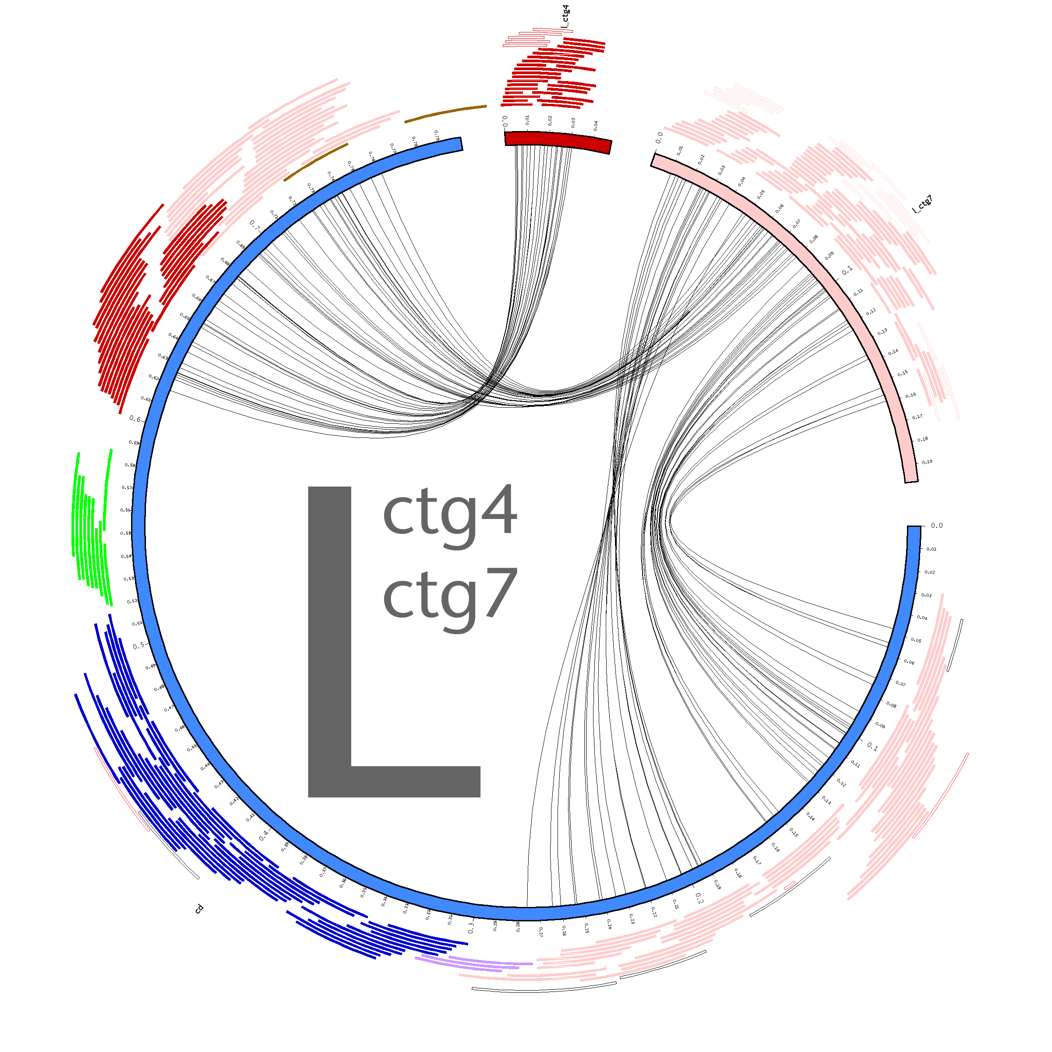
Applications

Slide 51
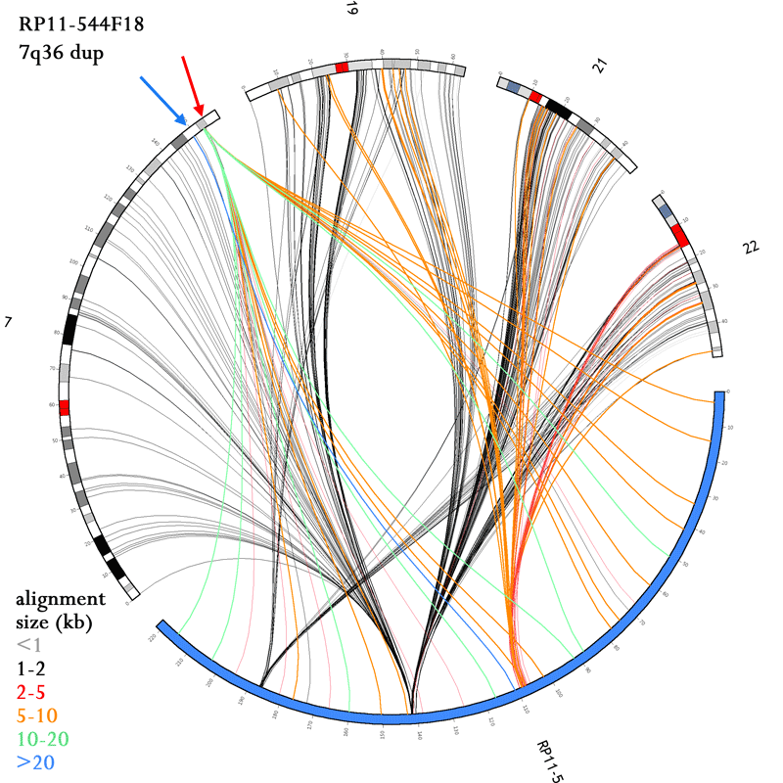
Applications

Slide 52
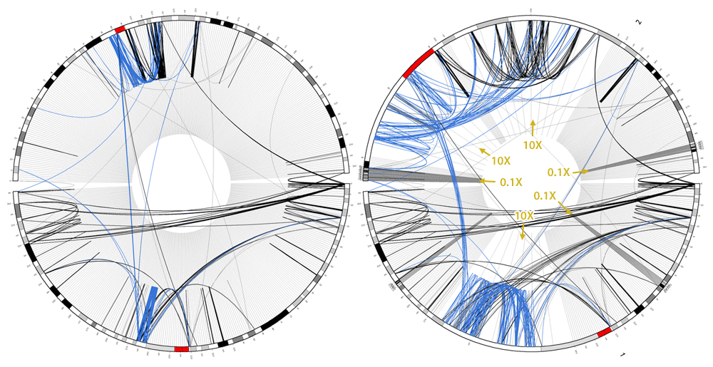
Non-Linear Scaling
genome is sparse
  large deserts of no features
  dense, distant groups of features
    of course, depends on what features!
Circos can locally expand/contract scale to zoom without cropping

Slide 53
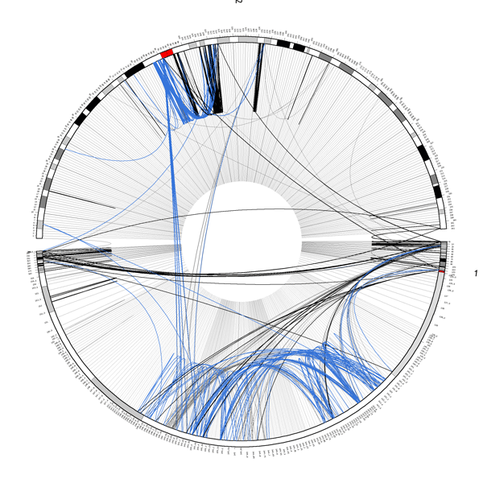
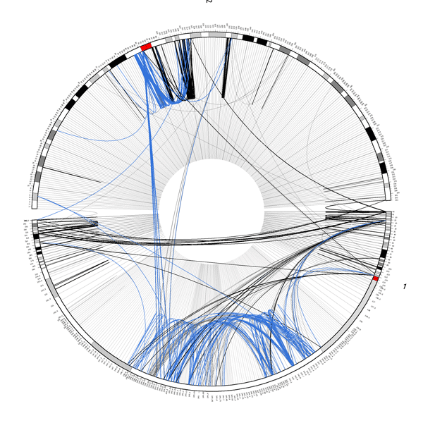
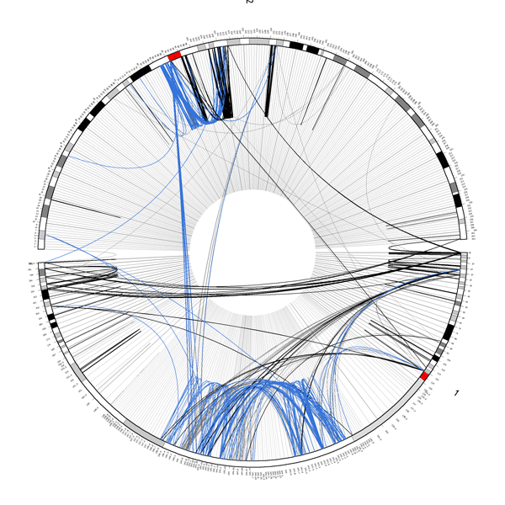
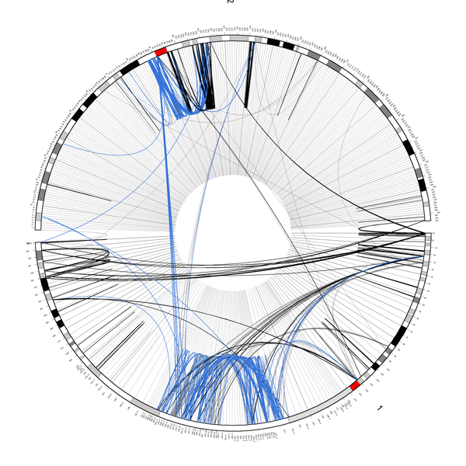
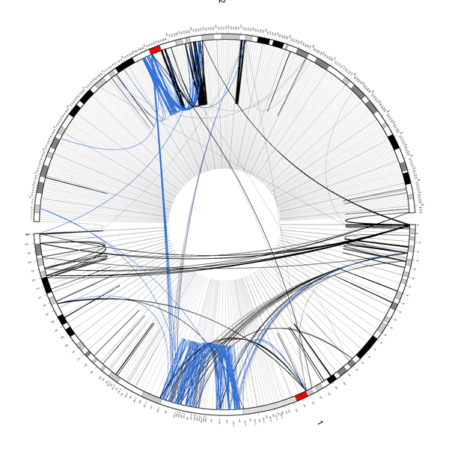
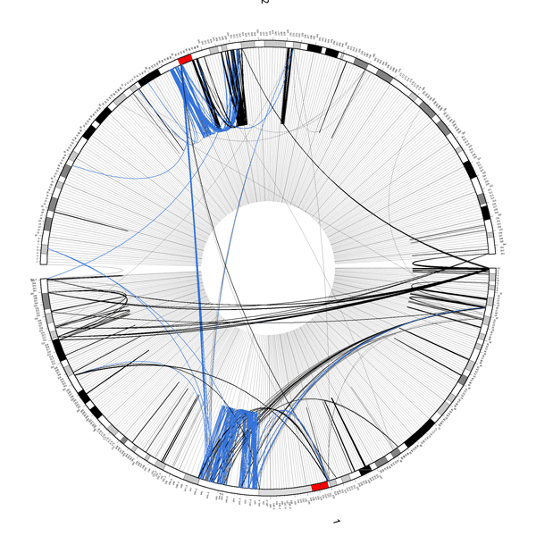
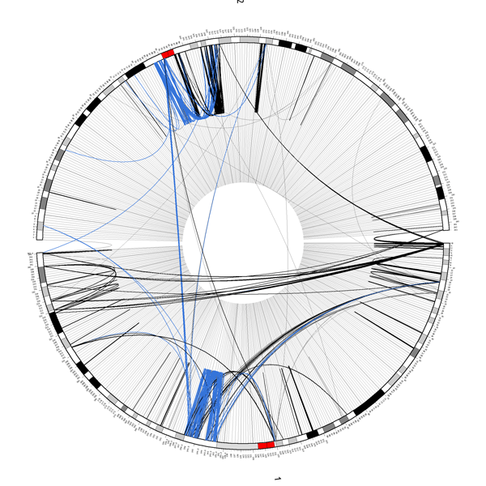
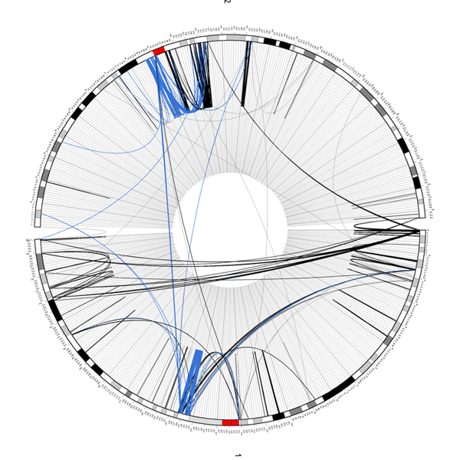
Non-Linear Scale
local scale contraction

Slide 54
